Slide 1


Slide 2

Image Classification

Slide 3
Introduction
Shabnam Irshad & Noshaba Tabsssum
BC200418293 & MC220201538
Group ID - S2402F4B7E

Slide 4

INTRODUCTION OF PROJECT
Develop an automated system to classify fruits (apples, oranges, bananas) as fresh or rotten using computer vision.Emphasizes the role of AI in the rapidly evolving field of Image Processing.
Classifies fruits into six categories: fresh/rotten apples, oranges, and bananas.Aiming to create a real-time system for swift and accurate image classification.

Slide 5
INTRODUCTION OF PROJECT
Utilizes the VGG16 deep learning.
Over 13,000 images from Kaggle, categorized into fresh and rotten fruits.
base with additional layers for 6-class classification.
Integrated with a desktop app using Tkinter for image upload and classification.

Slide 6
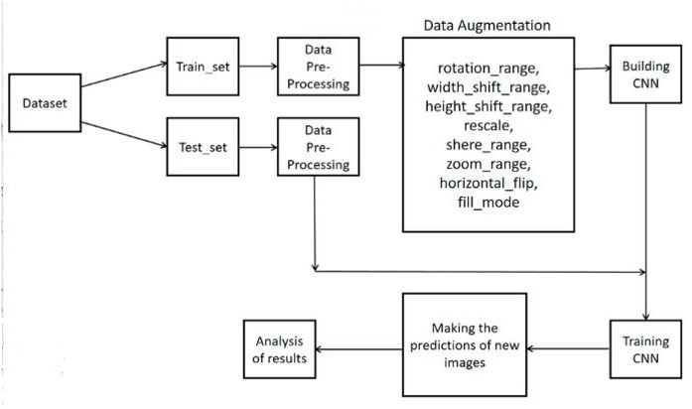
PROCESS MODEL
BC200418293 & MC220201538

Slide 7
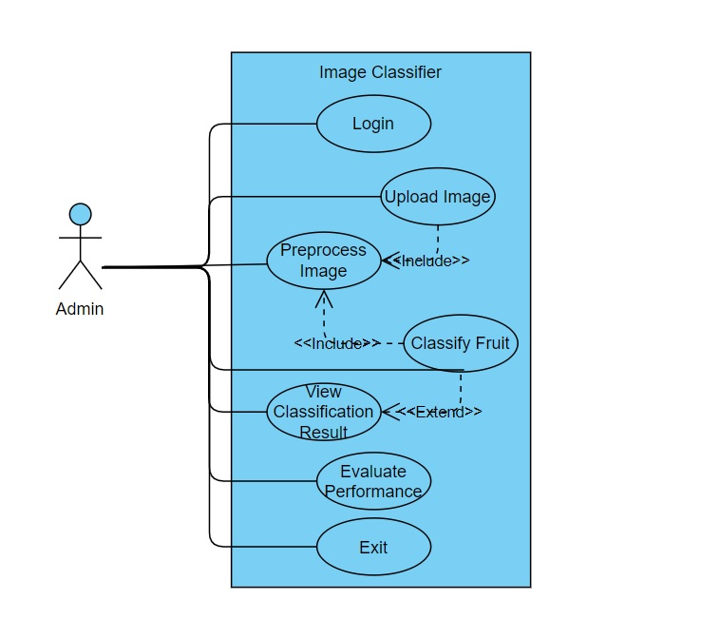
Use Case Diagram

Slide 8
Business Rules Catalog
Import the image dataset from specified link.
Image preprocessing and data splitting.
Training model with CNN.
The system should display the classification result (fruit type and freshness) to the user.
The system must have an easy-to-use interface for image upload and result display.
The system should evaluate classification accuracy, precision, recall, and F1-score.

Slide 9
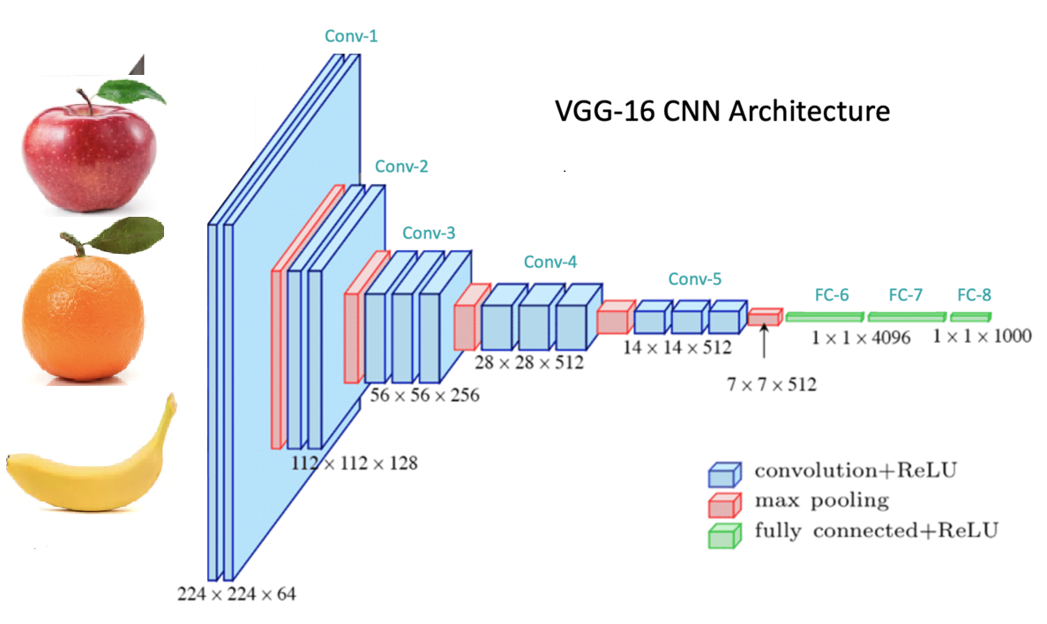
Architectural Design

Slide 10
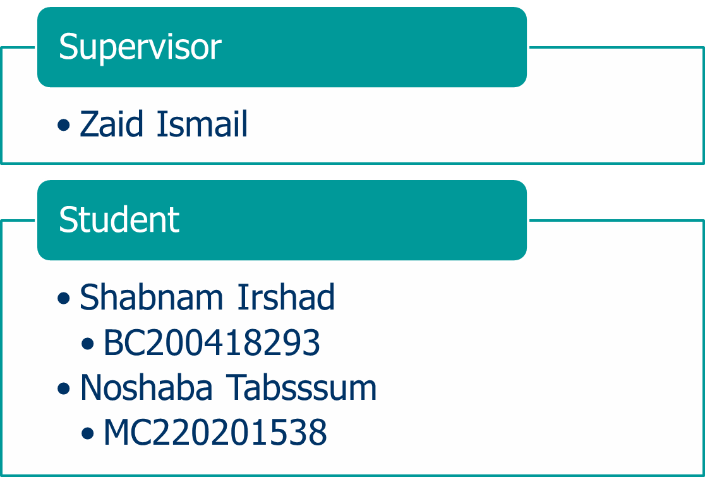
Team Structure

Slide 11
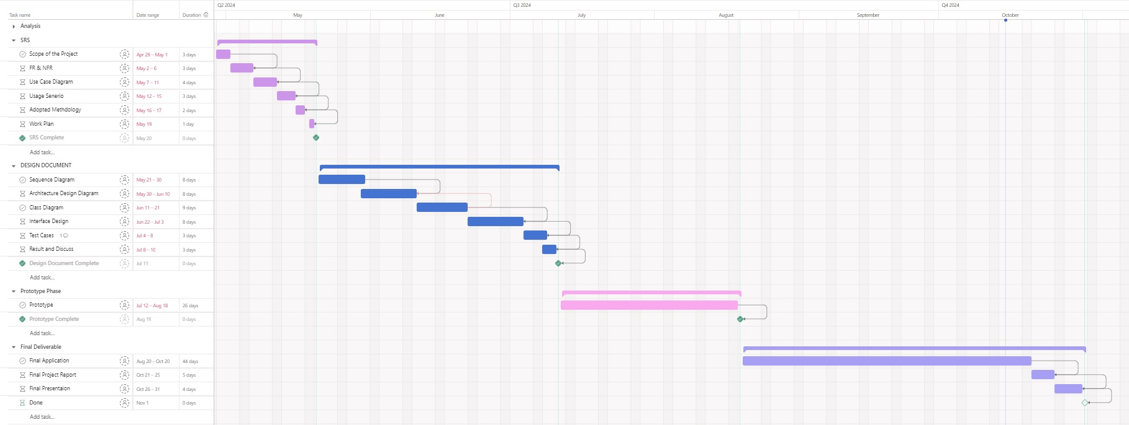
Project Schedule

Slide 12
Project Schedule

Slide 13
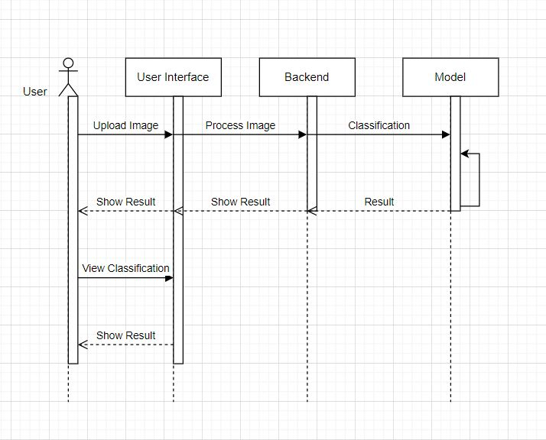
Sequence Diagrams

Slide 14
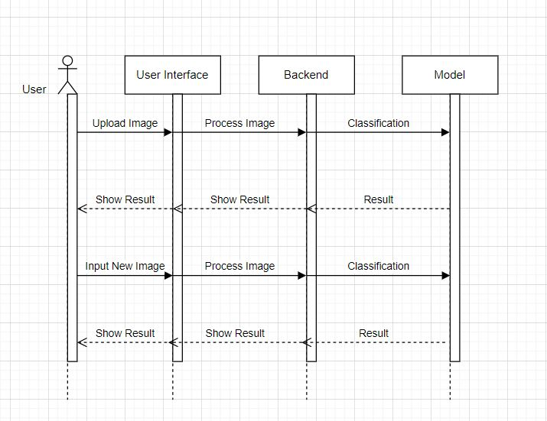
Sequence Diagrams

Slide 15
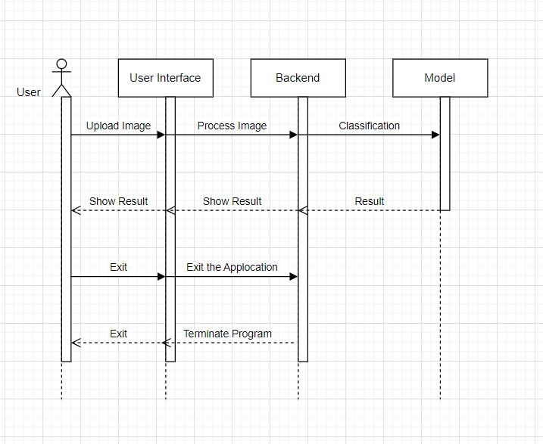
Sequence Diagrams

Slide 16
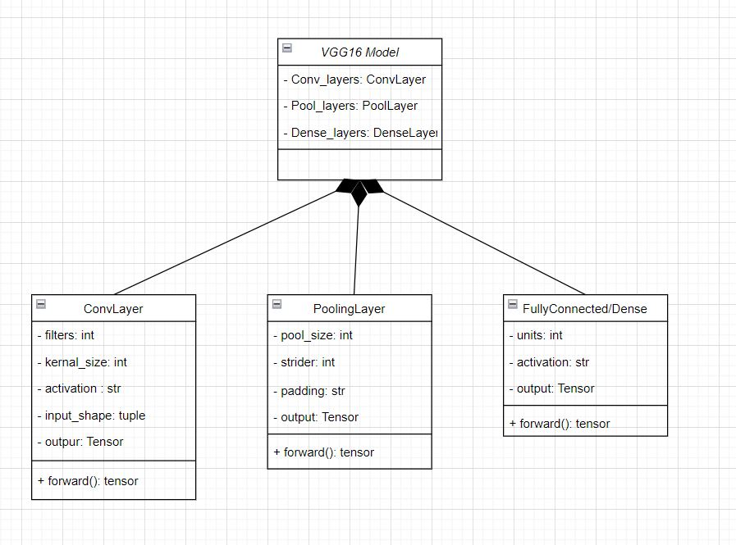
Logical Model/Class Diagram

Slide 17
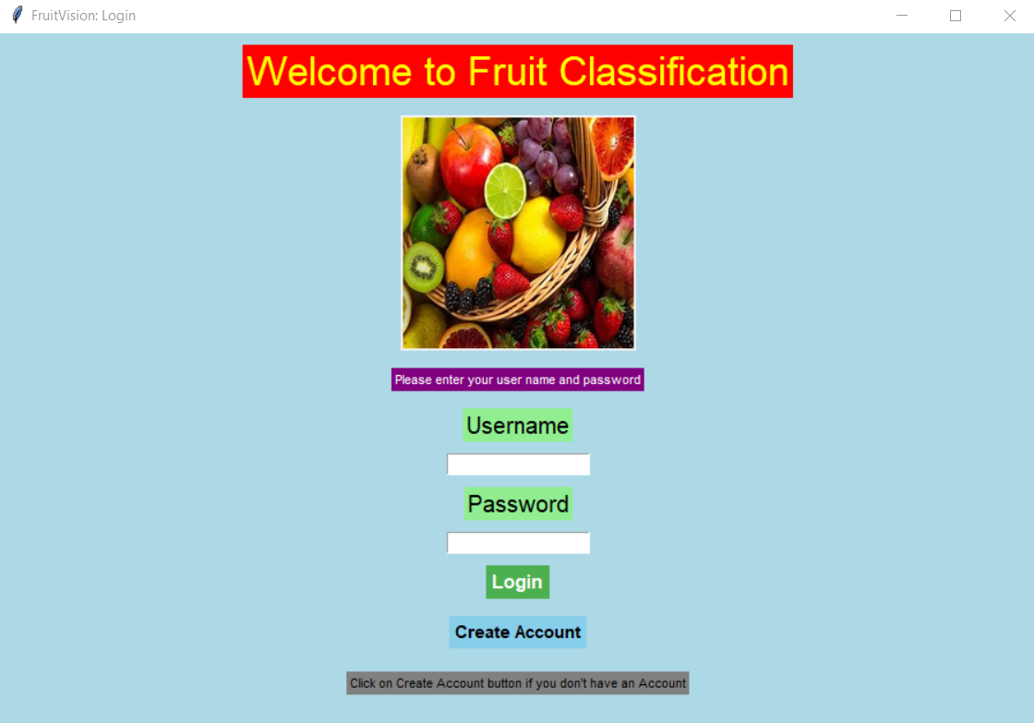
User Interfaces

Slide 18
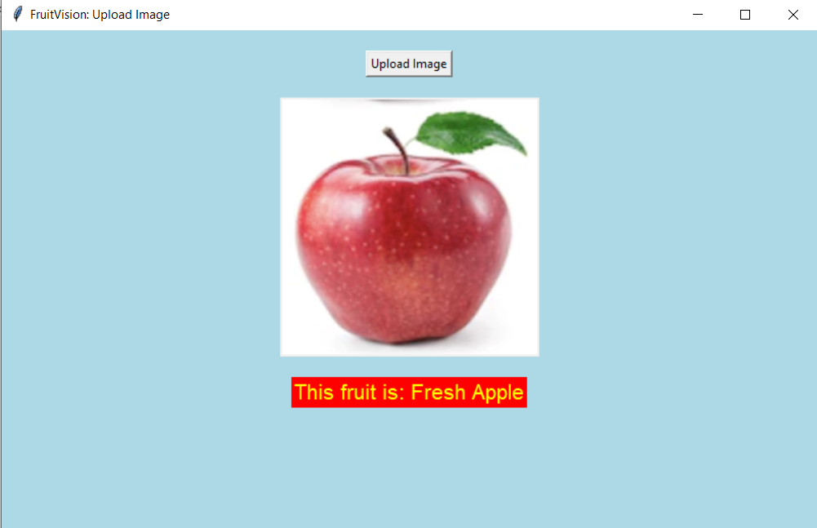
User Interfaces

Slide 19
TOOLS
Visual Studio Code.
Python.
Tkinter lib for GUI.
TensorFlow lib & Keras API.
VGG16 Architecture.

Slide 20


Slide 21
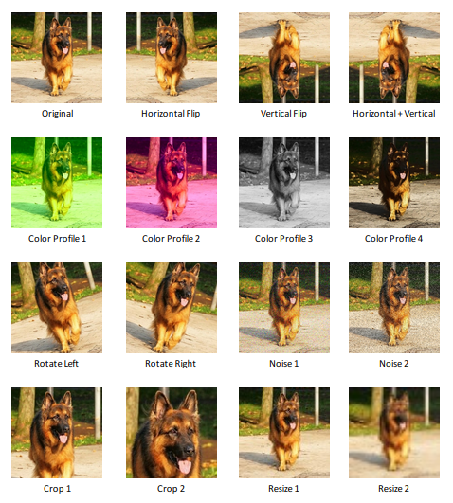
Data Augmentation

